Slide 1
2022-2nd Semester
Computer System
1st team project
< Big numbers >
21102052
Lee Jeong-yun
Team 4
21102050
Lee In-sun

Slide 2
table of contents
1
How to Represent Floating Number
2
Our Data Structure for Big Number
3
Arithmetic Operation – Given Number
4
Arithmetic Operation – Random Number
5
Exception & Limitation

Slide 3

Part 1
How to Represent Floating Number

Slide 4
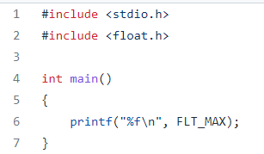
Part 1
How to Represent Floating Number
float_max.c
The largest floating number that can be represented by the built-in data type (float)
Use ‘FLT_MAX’ from ‘float.h’ : Constant containing the maximum value of float type.

Slide 5
Part 1
How to Represent Floating Number
Output of float_max.c

Slide 6

Part 2
Our Data Structure for Big Number

Slide 7
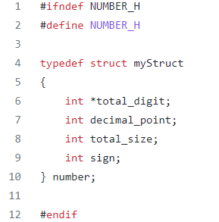
Part 2
Our Data Structure for Big Number
number.h
1. int *total_digit: put the numbers of each digit in the array and get the first address.
2. int decimal_point: store the location where the decimal point is displayed
3. int total_size: represent the overall size of a number
4. int sign: 1 if positive, -1 if negative, 0 if not determined value (dividing by zero)

Slide 8
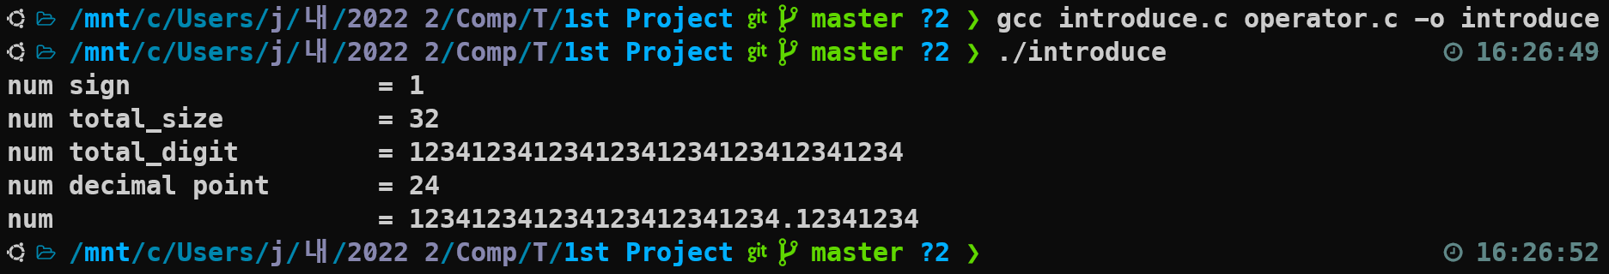
Part 2
Our Data Structure for Big Number

Slide 9

Part 3
Arithmetic Operation – Given Number

Slide 10
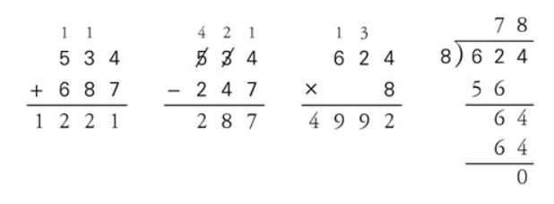
Part 3
Arithmetic Operation – Given Number
Step 1: put the number in the array without a decimal point
Step 2: compare two numbers and put ‘0’ to empty space in the result array to make the same length of array.
Step 3:
Carrying - When the number is over 10, divide 10 and the remainder leaves to result. Then sum the quotient to the front element of the array.
Borrowing - When elements with the same index number subtracted from each other is negative,
10 is lent from the preceding elements of the array.

Slide 11
Part 3
Arithmetic Operation – Given Number
+, -, * allocates the maximum number of possible digits of the calculation result to the result value, so it can be calculated regardless of the range of number
Divisions can be calculated within the range of 1,000 digits.
Decimal points are calculated separately and reflected in the output.

Slide 12
Part 3
Result of arithmetic operation between given numbers
A = 123412341234123412341234.12341234
B = 98989898989898989898989898. 9898989898989898989898
A + B → Possible
A – B → Possible
B – A → Possible
A * B → Possible
A / B → Wrong Result
B / A → Possible

Slide 13
Part 4
Arithmetic Operation – Random Number

Slide 14
Part 4
Result of arithmetic operation between random numbers
A = -1.737948554369722
B = 8.006883377502920
A + B → Possible
A – B → Possible
B – A → Possible
A * B → Possible
A / B → Possible
B / A → Possible

Slide 15

Part 5
Exception & Limitation

Slide 16
Part 5
Exception & Limitation
Automatic termination when an invalid number or operator is entered.
2. If the input is insufficient or too much, it will be automatically terminated.
3. Flexible decimal number input, for example, ‘ 0.4 ‘ can be recognized even if expressed as ‘ .4’
4. For addition, subtraction, and multiplication, before printing output, allocates the maximum memory of digits.

Slide 17
Part 5
Exception & Limitation
5. For all operations, the sign of the operand does not matter
6. when divided by 0 in the division, print the Error message output and terminate automatically.
7. If the division’s integer part exceeds the unsigned long-range, the calculation is automatically terminated.
8. Most of division cases can be performed correctly, however, the program returns wrong answers in partial expression.

Slide 18
Part 5
Open the code
&
Check the result

Slide 19
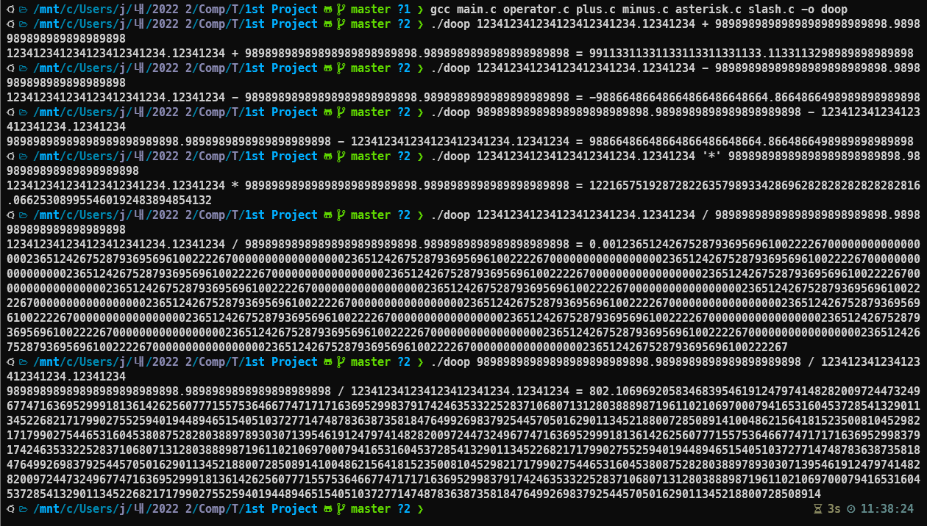

Slide 20
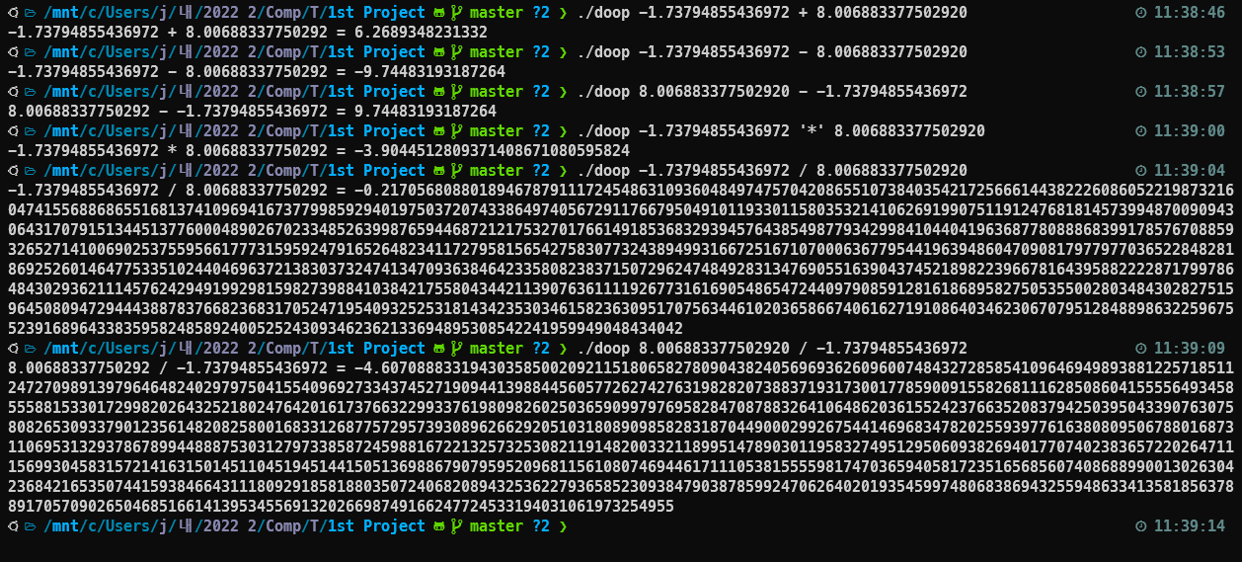

Slide 21
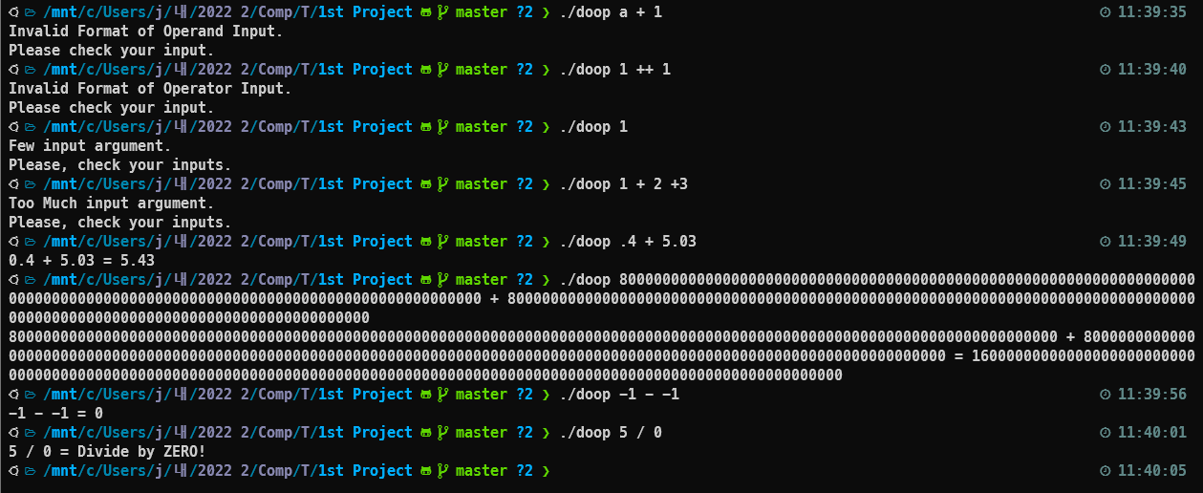

Slide 22
2022-2nd Semester
Computer System
Thanks.
21102052
Lee Jeong-yun
21102050
Lee In-sun

